Slide 1
A Study of Netflix Stock development over 2017
Notes:
A title slide
A list of your visualizations and your role in their creation for the "Stock Profile" team
A visualization of the distribution of the stock prices for Netflix in 2017
A visualization and a summary of Netflix stock and revenue for the past four quarters and a summary
A visualization and a brief summary of their earned versus actual earnings per share
A visualization of Netflix stock against the Dow Jones stock (to get a sense of the market) in 2017

Slide 2
Table of visualisations
1. Violin plot of close price
2. Bar plot of Revenue vs Earnings
3. Scatter plot of Estimates vs Actuals
4. Line chart comparing Netflix against the Dow Jones industrial average
Author: Max Radelius, Stock Profiling Team

Slide 3
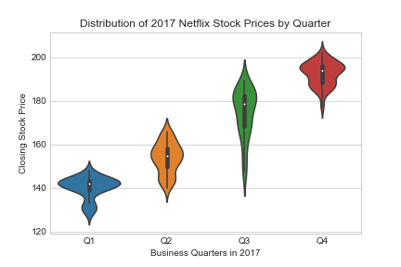
Distribution of Netflix stock price
The stock prices where mostly clustered around the mean.
Q1. Distribution is heavily binomial, indicating a relatively steady close price.
Q2. The wider distribution indicates a phase of volatility for the stock.
Q3. The wide distribution indicate large volatility in the stock.
Q4. The return to a clustering around the mean and a binomial distribution indicate a period of less volatility
Low ~ 121
High ~ 205

Slide 4
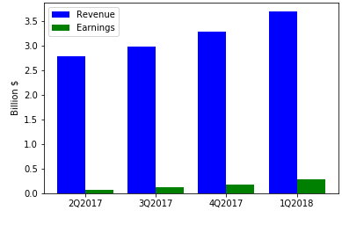
Netflix revenue and earnings growth
Summary:
Both Revenue and Earnings are in growing trend.
Revenue is outperforming earnings as seen by the slope of the trend line.
Earnings as a proportion of revenue range between 2% in Q22017 to 8% in Q12018

Slide 5
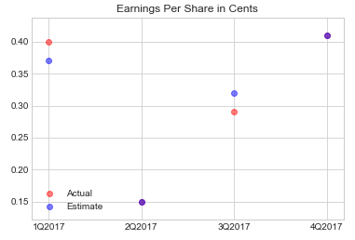
Beating Estimates
Summary:
Estimates for Netflix are quite accurate with actuals hitting estimates in Q2 and Q4.
Its clear that the market expectation of Netflix in Q1 was lower than warranted and that the following market adjustment of estimates was excessive for Q2.
The market expected a earnings jump in Q3 that was not motivated by previous earnings reports, where we see a steady growth.

Slide 6
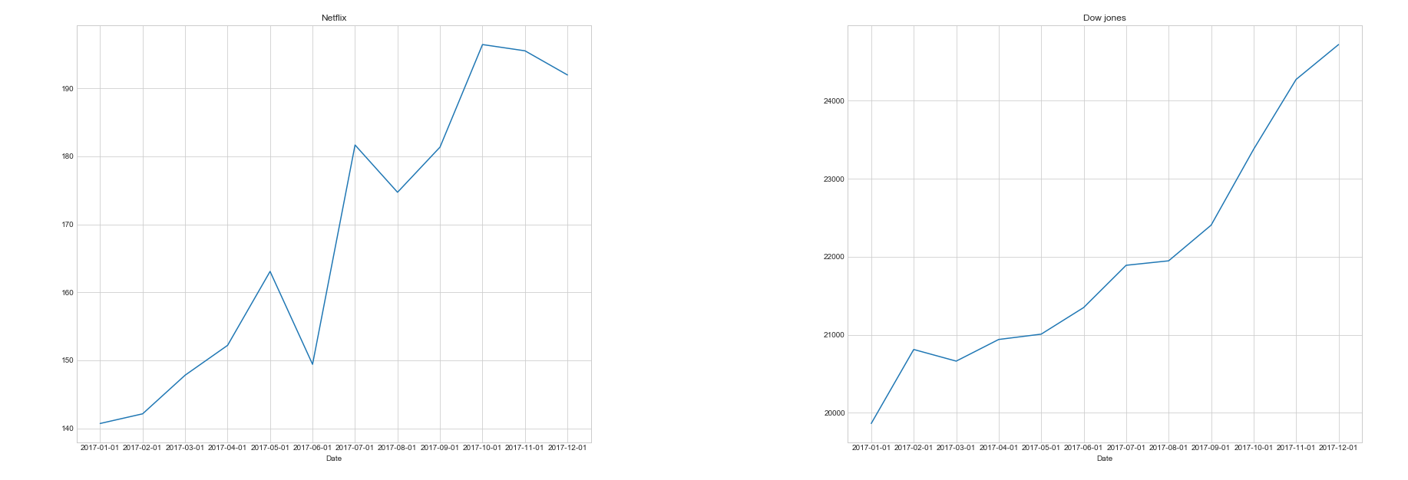
Netflix compared to Dow Jones
Analysis: Comparing Netflix against the Dow Jones industrial average one can conclude that Netflix is in general following the upwards trend of the market.
Though being a individual stock Netflix shows significant volatility compared to the Dow Jones index, as seen in for example June
In terms of absolute numbers Netflix outperformed the Dow, with an appreciation of ~35% over the year compared to the Dows ~20% growth.

Slide 7
Conclusion
Market expectations for Netflix are high
The stock is in a growing trend, following steadily increased revenue and earnings
There is a higher amount of volatility in Netflix as compared to the Industrial average (as would be expected).
Netflix has outperformed the industrial average with almost 75%
Recommendation: Buy signals based on these fundamentals, but await a dip in the price.

